Slide 1
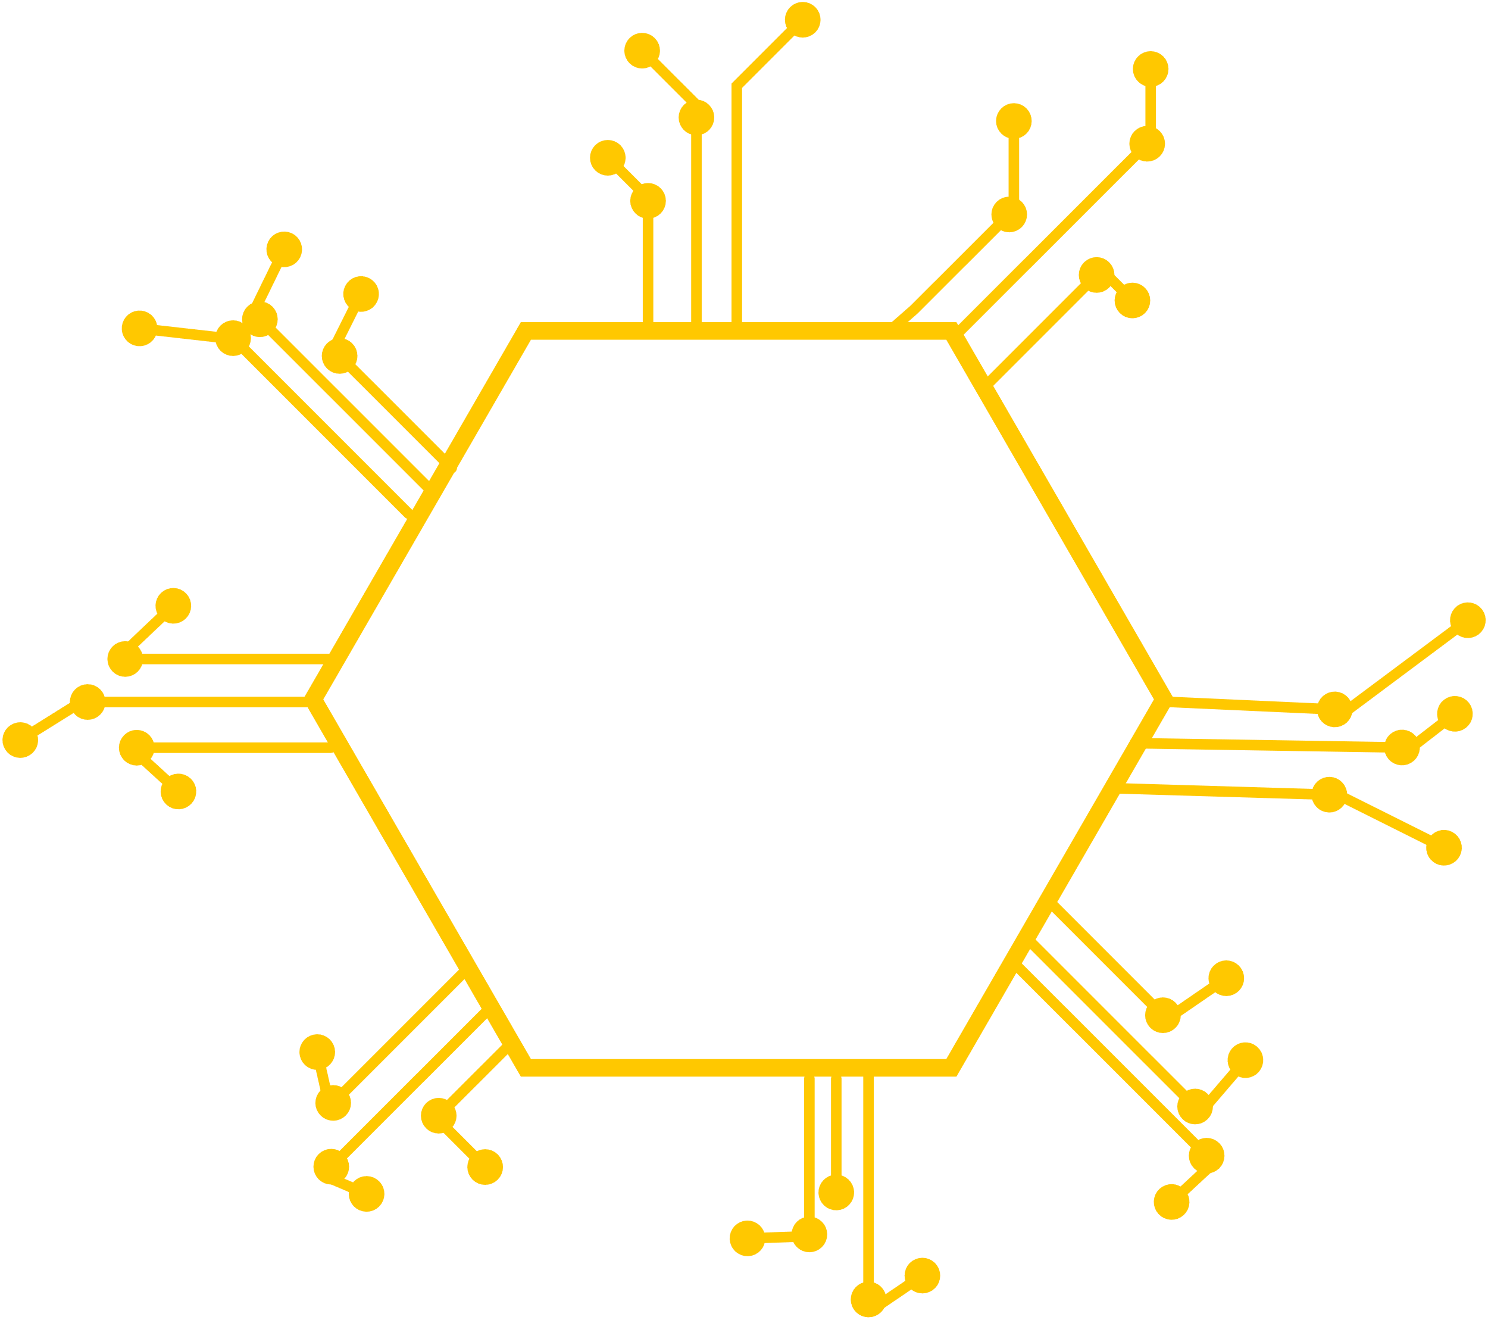
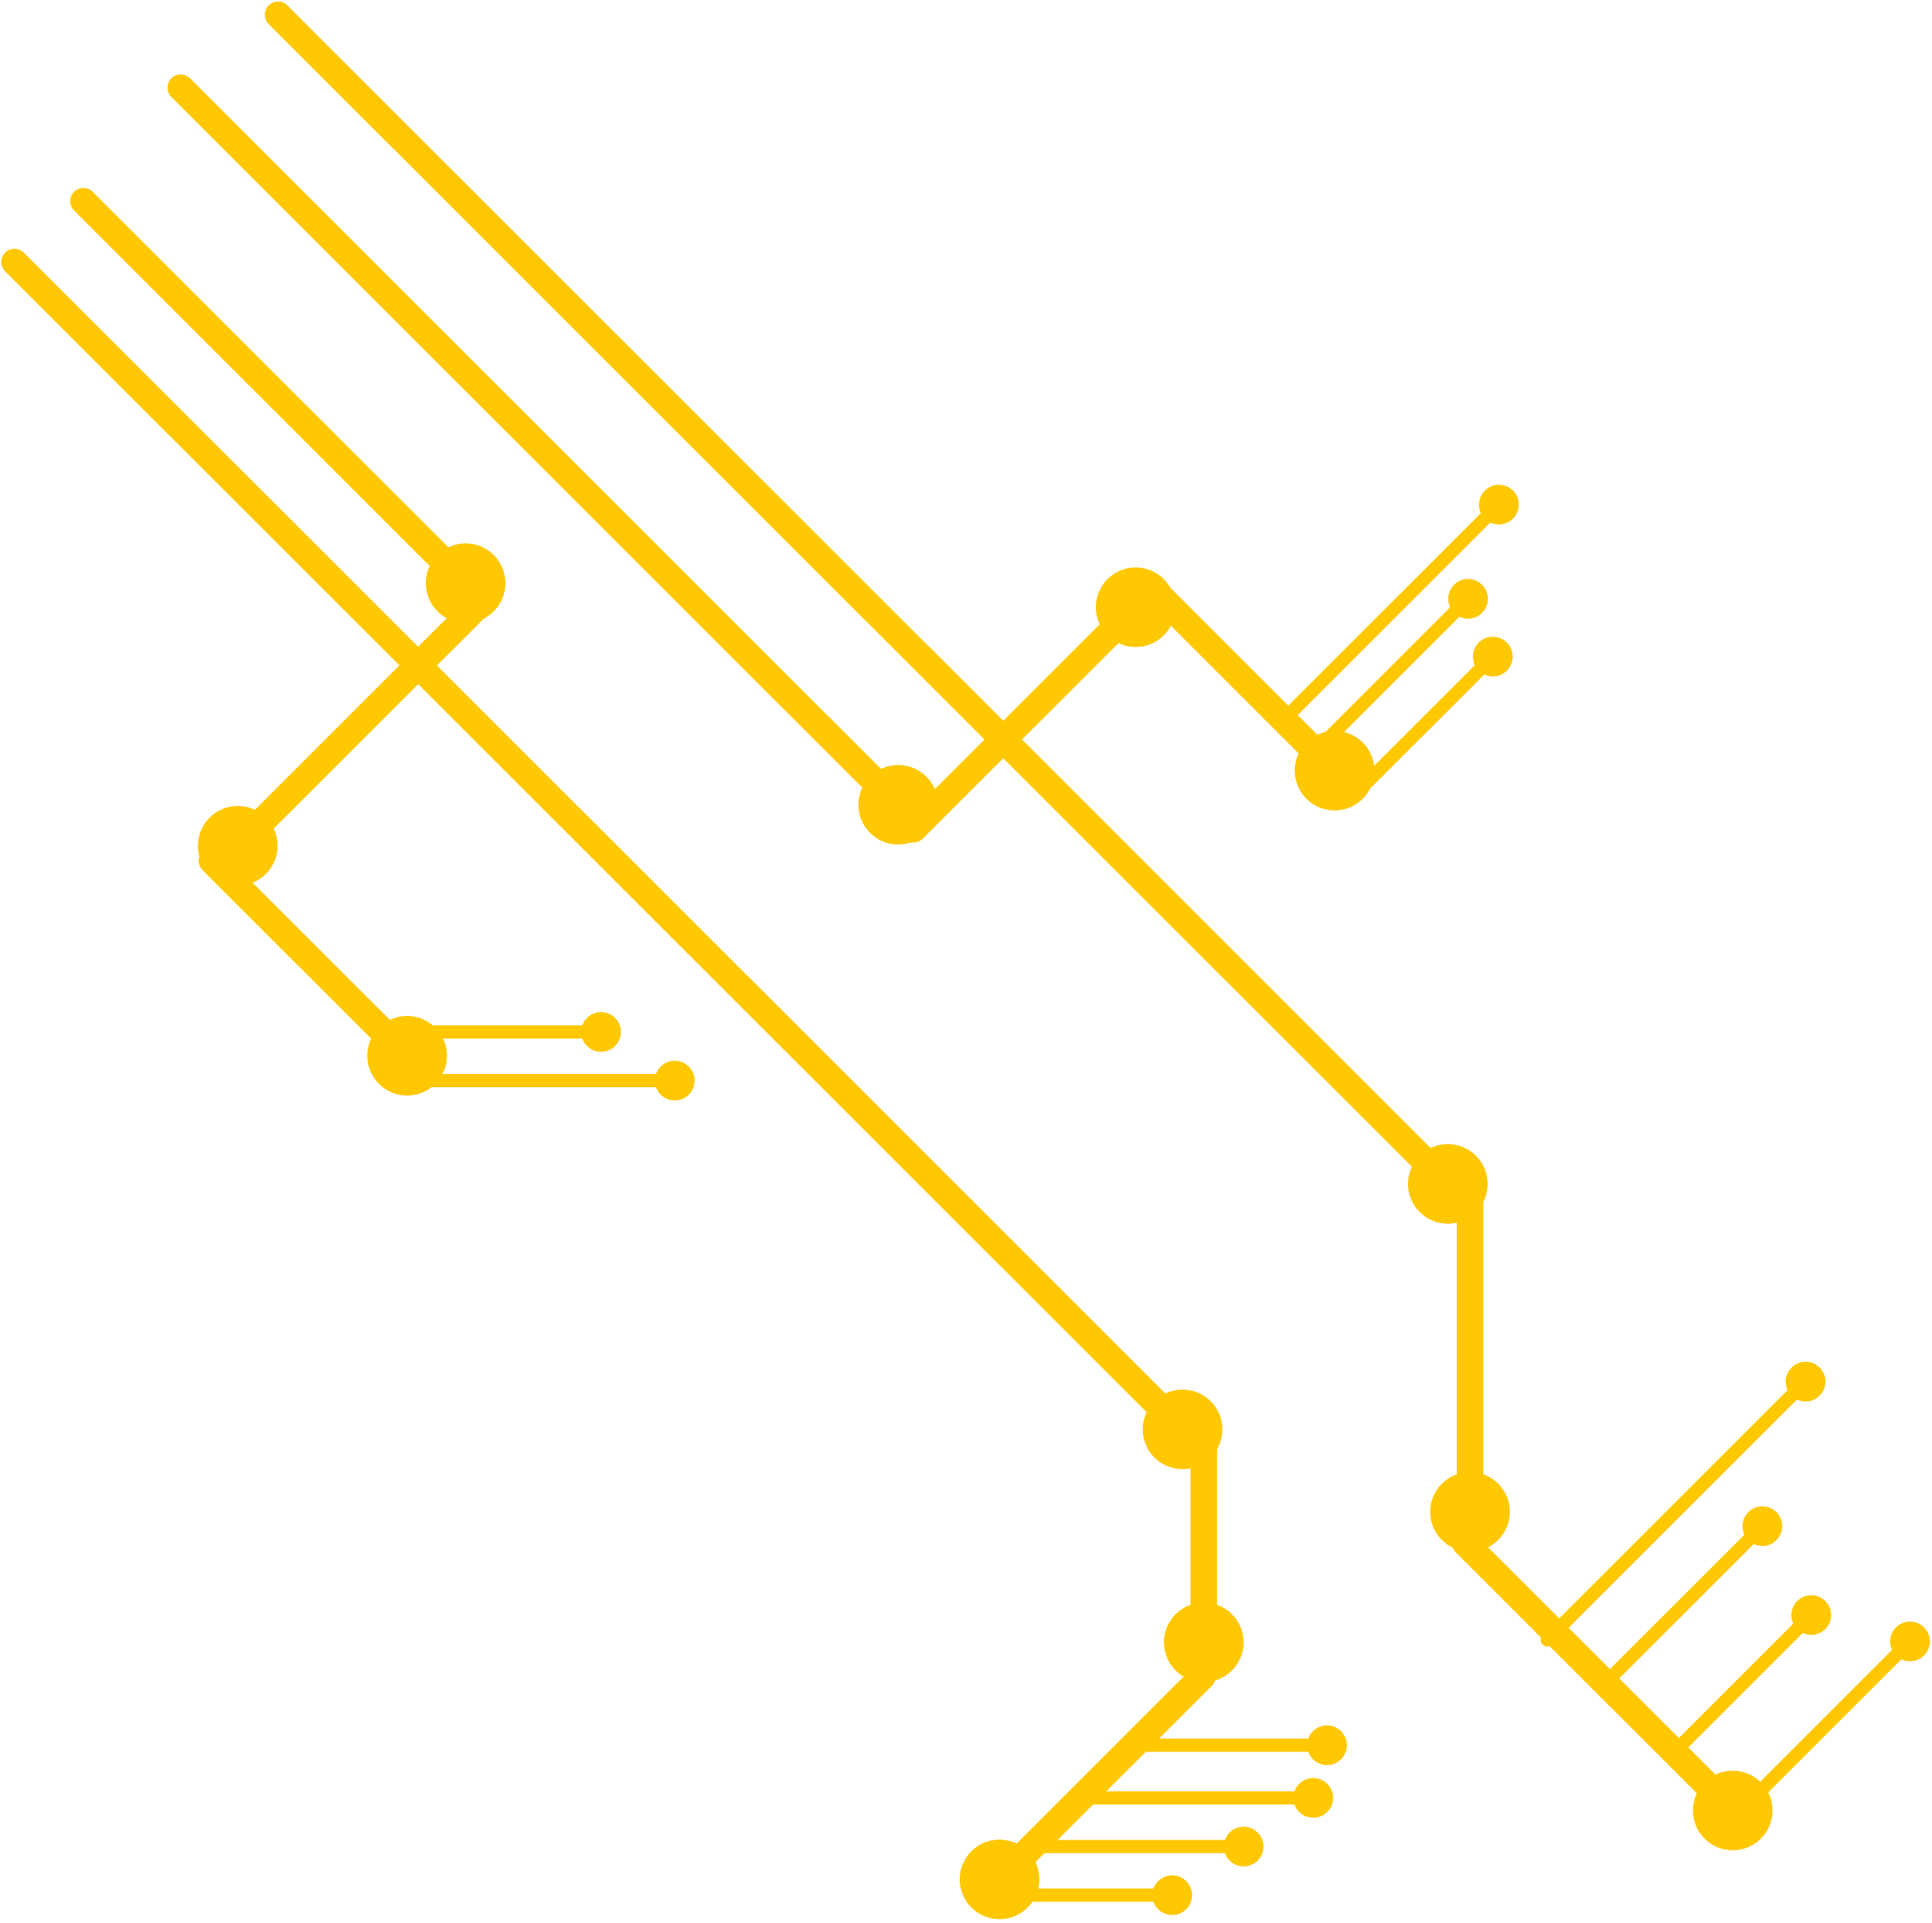


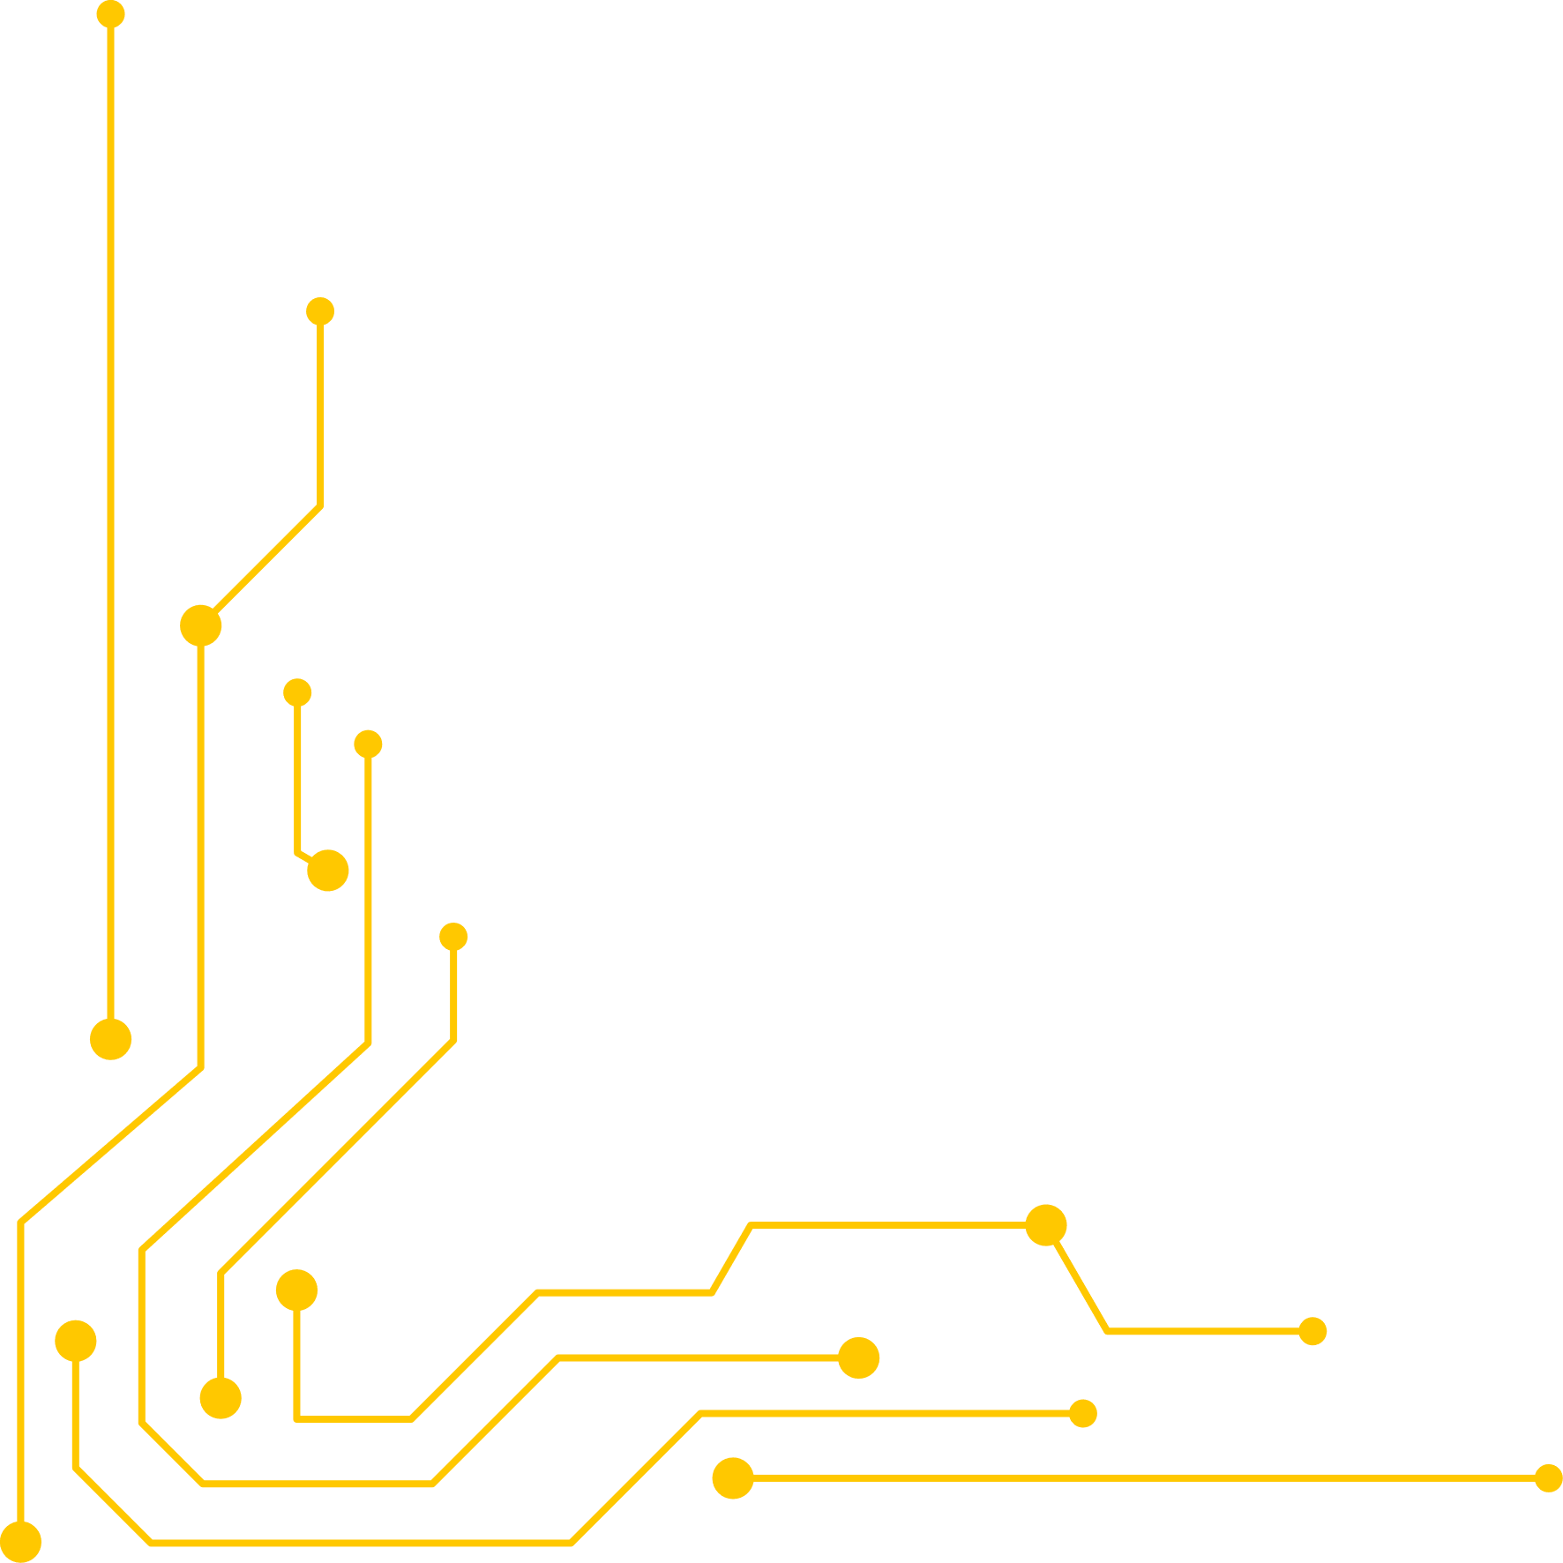
TERRACORE
COMMUNITY
WELCOME
TO OUR SLIDE
Let's Focus On Our Slide Until End
<<< Made BY >>>
Danish & farriz

Slide 2
Welcome
About
Used Tools
This slideshow is about our website page Terracore.hub, Which is a website for the roblox players to get a full information about Terracore roblox game.
ChatGpt
PowerPoint
Canva
Visual Studio Code
Google Chrome
XAMPP
Localhost
Roblox
Gmail
Discord
Guilded
Instagram
Tiktok
Facebook
YouTube
Roblox Studio
Github

Slide 3
Terracore.hub and Terracore Roblox Game Founder
Developer
Moderator
Muhammad Danish Haikal (aka DH-Nics)
Farriz Haqiem bin Basyir

Slide 4
Link
Terracore.hub:
Localhost/TerracoreCommunity/index.html
Make sure the Apache and MySQL are started (XAMPP run as administrator) before using this link and make sure the website folder and file exist in xampp > htdocs

Slide 5
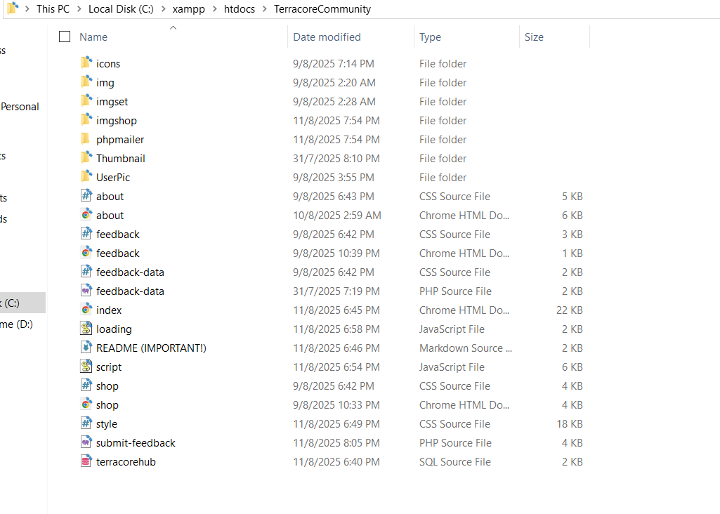
Folder and File

Slide 6

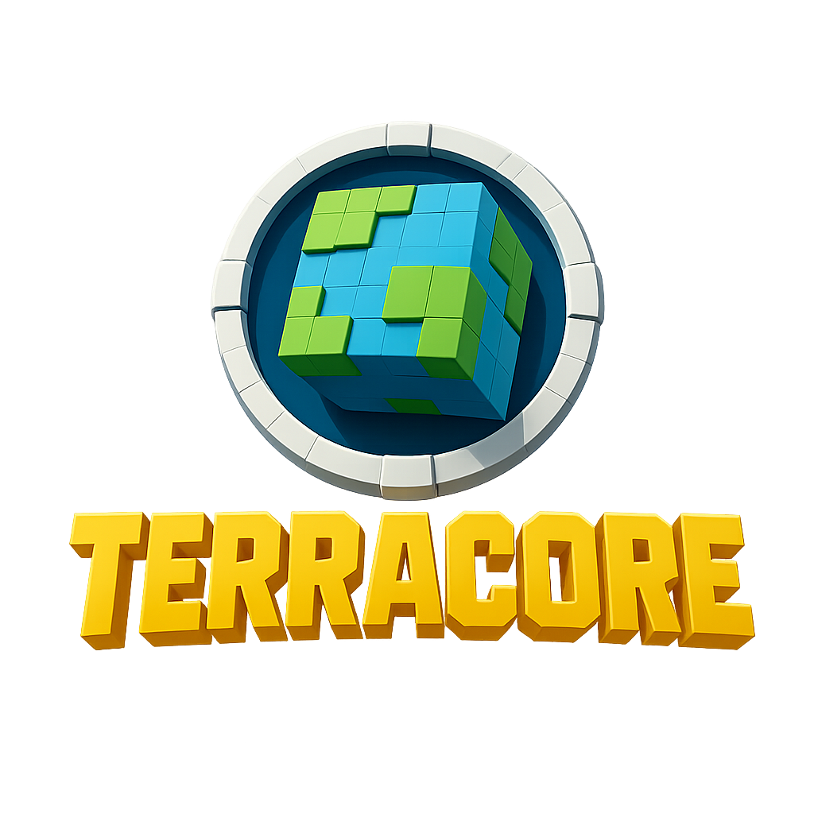

Slide 7
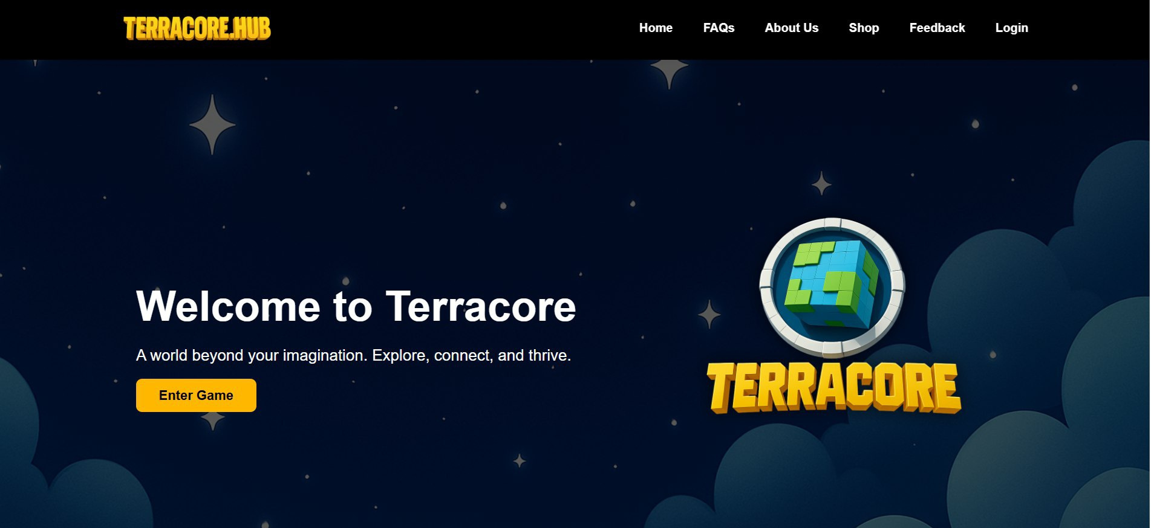
Main Page
This is where the page goes when
the users opens the website
It has the header that makes it
easier for the users to get
access

Slide 8



<< Game button >>
-it will go to the
Roblox game page

Slide 9
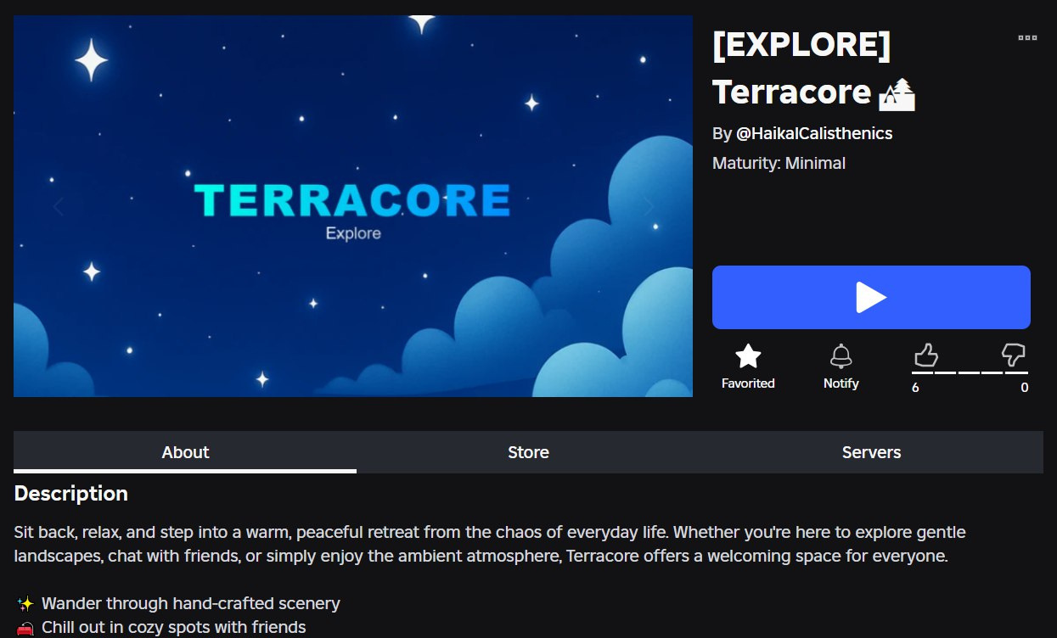
Roblox Game Page

Slide 10
<< Logo & Nav button >>
-Basically, it will reload the page when clicked.

Slide 11
<< Home Button >>
-When clicked, the page will go to the
description section

Slide 12
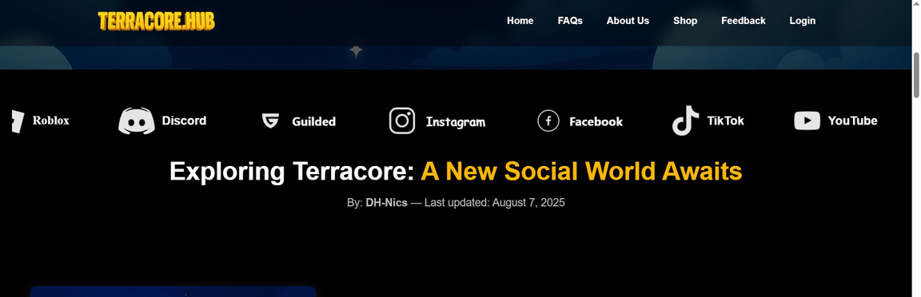
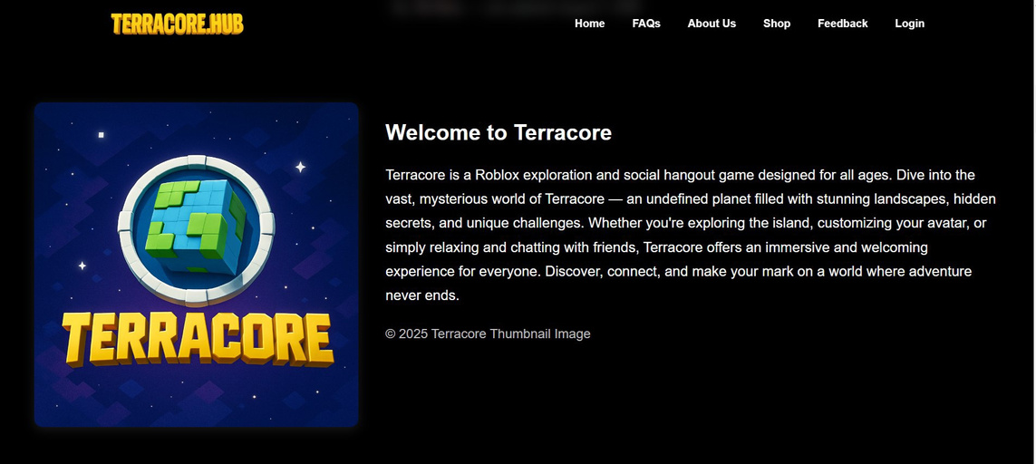
Home Page - Description
Section
This section serves as the welcoming area of the Terracore website. It introduces visitors to the game’s concept, setting, and purpose.
The description highlights what Terracore is, the type of experience players can expect, and encourages them to explore further. It sets the tone for the rest of the site, combining a brief overview with an inviting visual, such as the game’s thumbnail image.

Slide 13
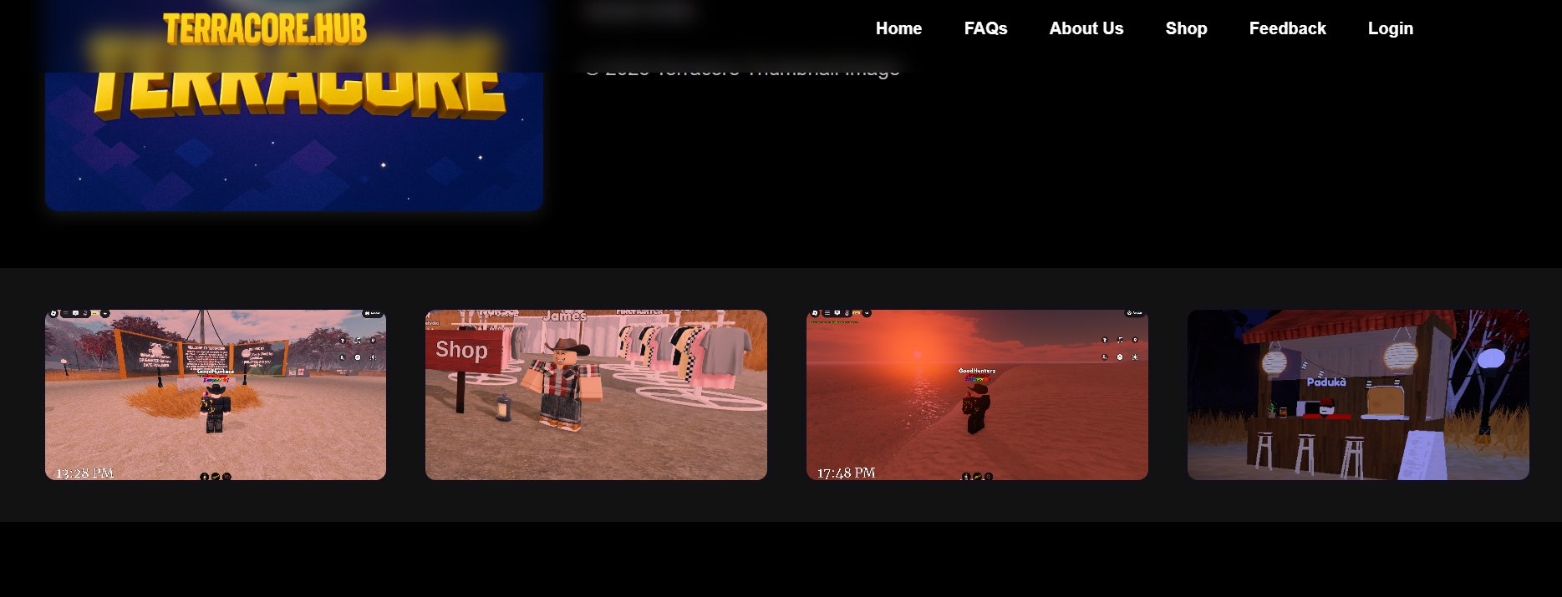
Home Page - Description Section (Gallery)

Slide 14
<< FAqs button >>
-when clicked, it goes to the frequently ask question (faq) section

Slide 15
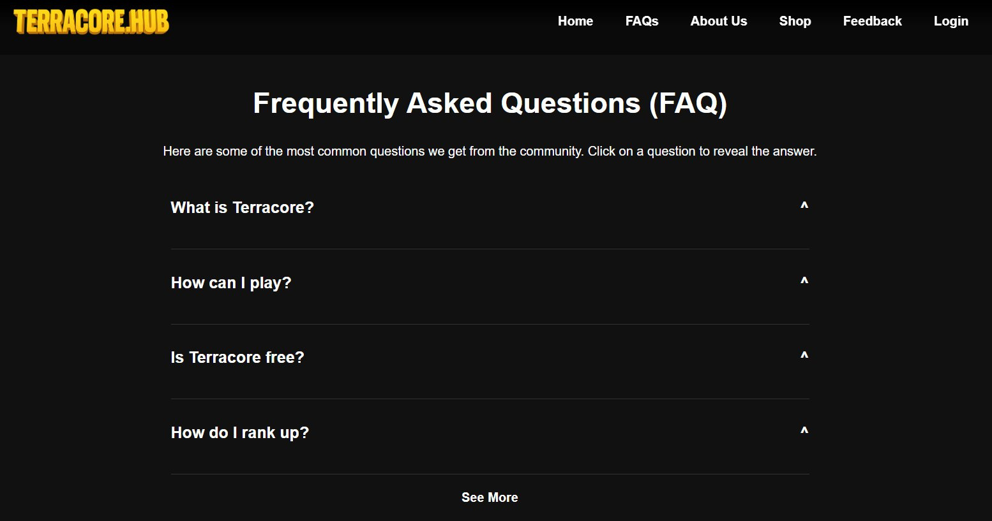
Home Page - FAQ (Frequently Asked Questions) Section
This section provides answers to the most common questions about Terracore, helping visitors quickly find information without needing to contact support. It covers gameplay basics, rules for becoming a moderator, community guidelines, and other important details.
By consolidating key answers in one place, it improves user experience and keeps players informed about the game and its community standards.

Slide 16
<< About us >>
-When clicked, it will go to the About us page

Slide 17
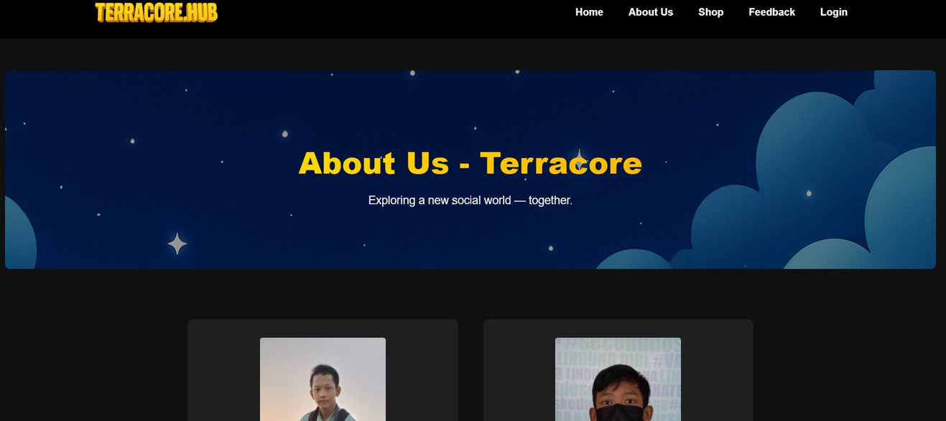
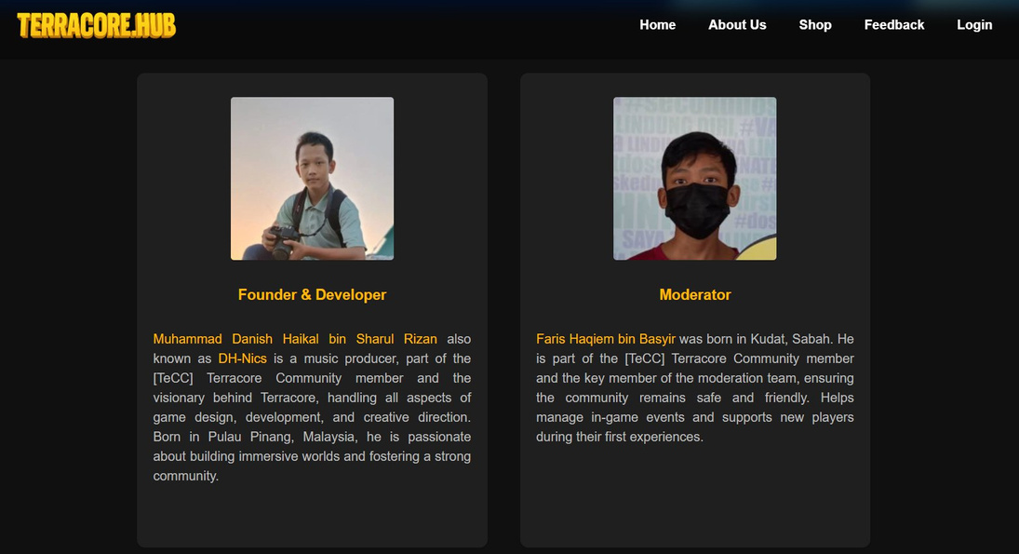
About Us Page
Danish Haikal aka DH-Nics, who leads the game's design and development, and our Moderators, Faris who help maintain a safe, friendly, and fair environment for all players. It also highlights our values, player engagement goals, and dedication to regular updates.
Provides an overview of the Terracore community, its purpose, and mission. It explains how Terracore was created to offer an exciting and safe social hangout experience for Roblox players of all ages. The section introduces the key people behind the project — Founder & Lead Developer:

Slide 18
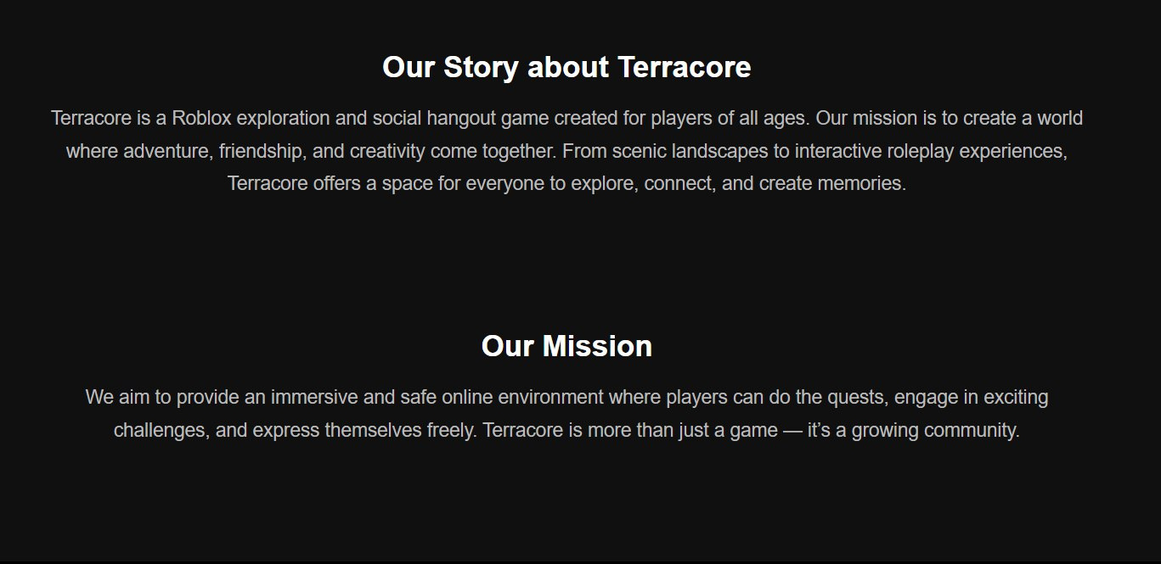

Slide 19
<< Shop Button >>
-When clicked, it goes to the Gamepass shop page

Slide 20
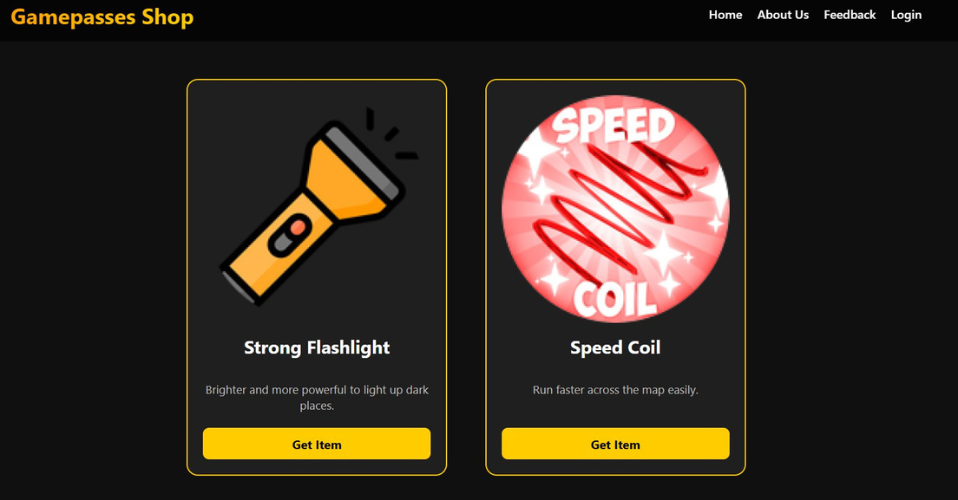
Gamepass Shop Page
Displays all available Gamepasses for purchase in Terracore. Each item is presented with its image, name, description, and a direct purchase link to the official Roblox gamepass page. The section is designed for clarity and quick access, allowing players to understand the benefits of each item before buying.
Examples include tools like the Strong Flashlight for better visibility and the Speed Coil for faster movement. The layout ensures a clean, organized, and user-friendly shopping experience.

Slide 21
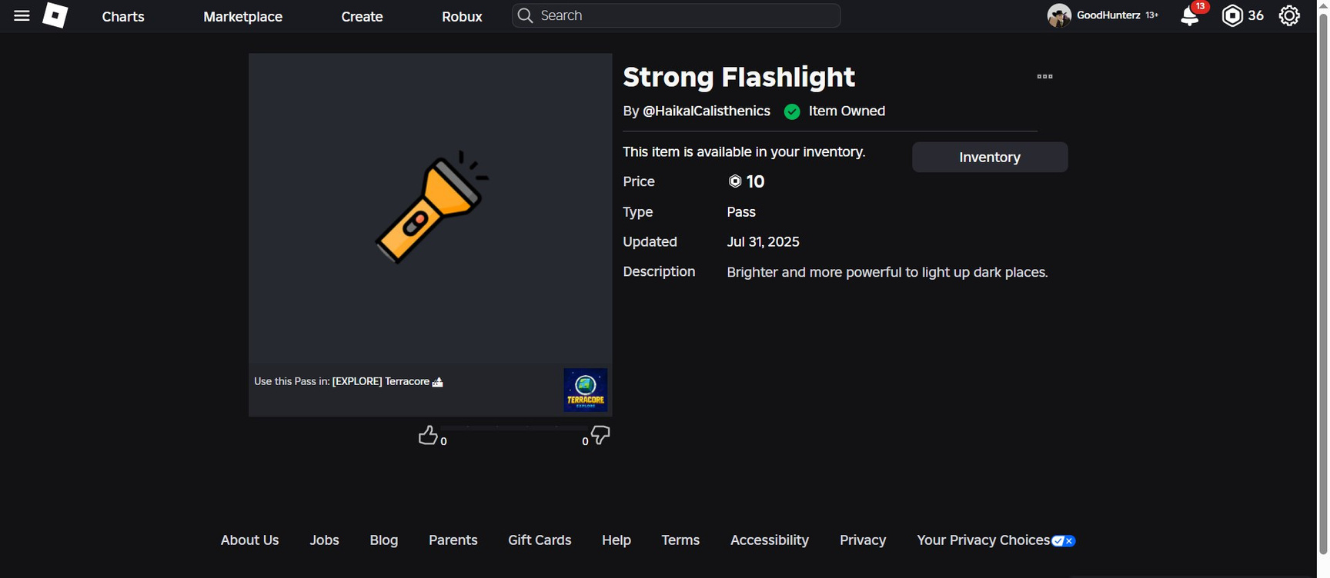
Strong Flashlight/Torch
Usage in Game: The Strong Flashlight is equipped to illuminate dark areas in the Terracore map, making exploration in low-light environments much safer and easier.
How It Helps: Perfect for exploring caves, night-time scenarios, or dimly lit interiors, it allows players to spot obstacles, find hidden paths, and interact with the environment more efficiently.
Price: 10 Robux (Gamepasses)
This is where the page goes to when player click get items on the shop page on Terracore.hub

Slide 22
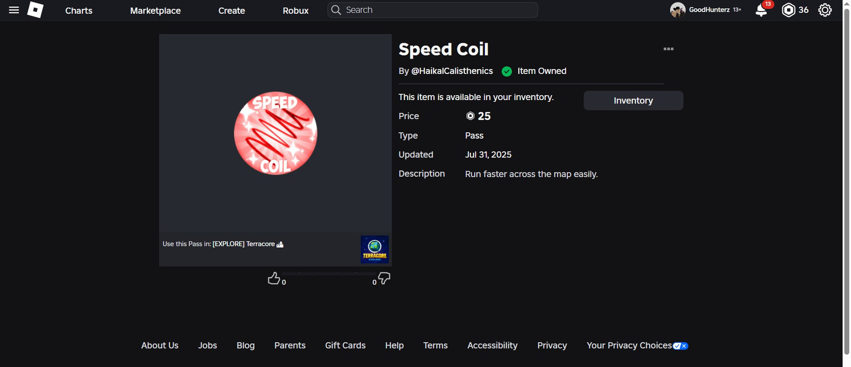
Speedcoil
Usage in Game: The Speed Coil is held and activated to boost the player’s walking/running speed significantly.
How It Helps: Ideal for quickly traversing large areas of the map or reaching objectives faster during events. It’s also a great advantage in exploration challenges.
Price: 50 25 Robux (Gamepasses)
This is where the page goes to when player click get items on the shop page on Terracore.hub

Slide 23
<< Feedback Button >>
-When clicked, it goes to the Feedback page

Slide 24
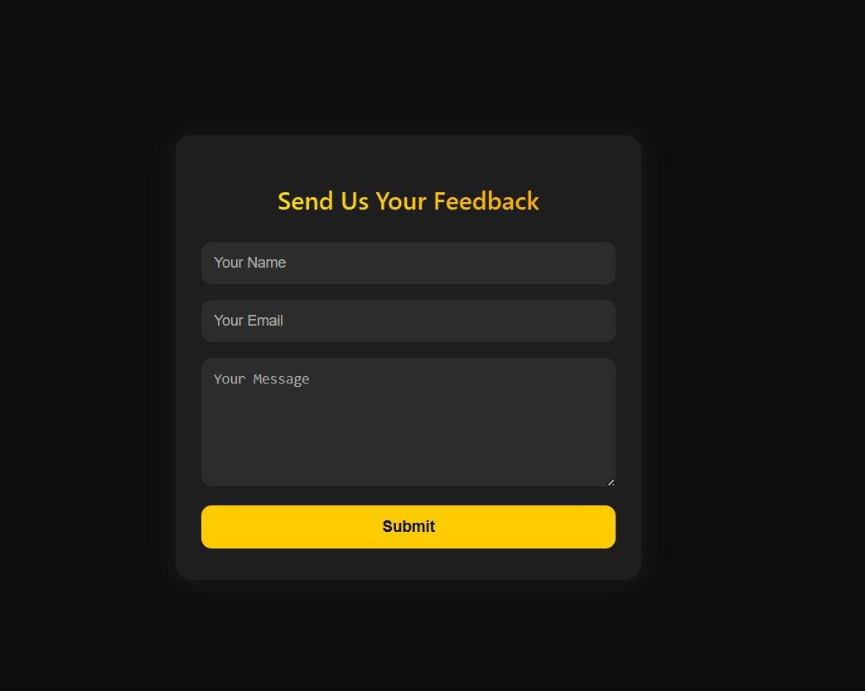
Feedback Page
Once submitted:
The feedback is saved into the MySQL database for tracking and reference.
An automated email notification is sent to the admin using PHPMailer and Gmail’s SMTP service:
The email contains the sender’s name, email address, and message content.
This ensures the developer is instantly notified of new feedback without needing to check the database manually.
This section allows players and visitors to send feedback directly to the Terracore team. The form contains three required fields — Name, Email, and Message — ensuring that every submission is complete and traceable.

Slide 25
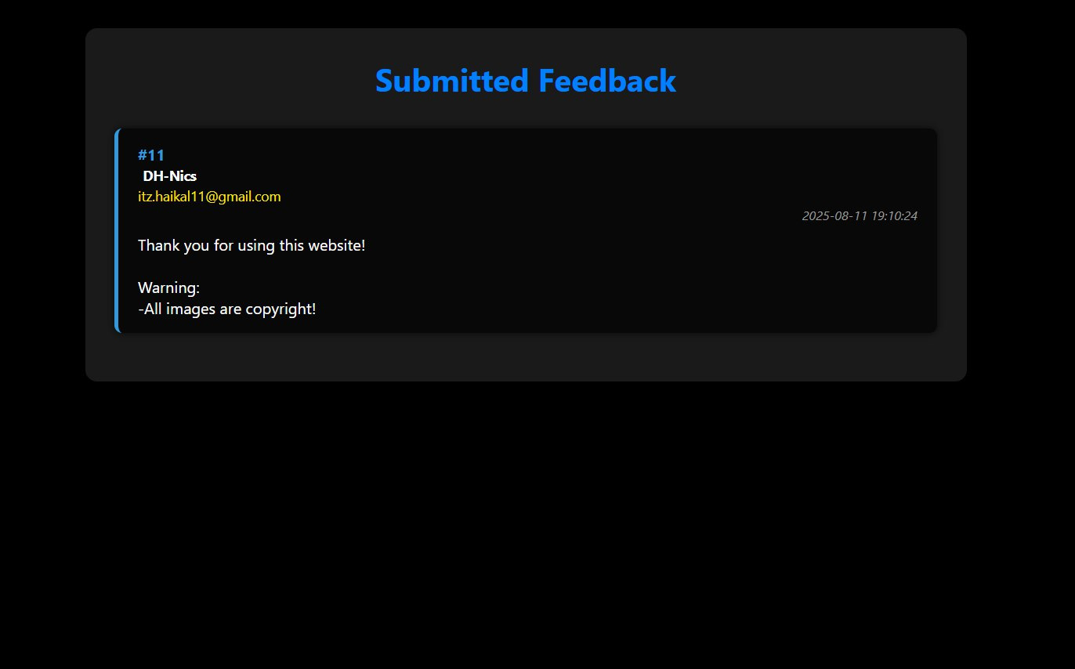
Submitted Feedback Data

Slide 26
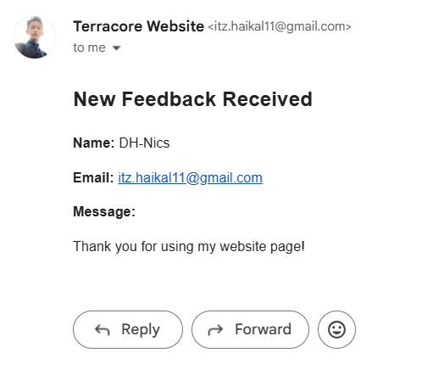
Submitted Feedback Data (Gmail)

Slide 27
<< login >>
-When clicked, it goes to the Roblox Login page

Slide 28
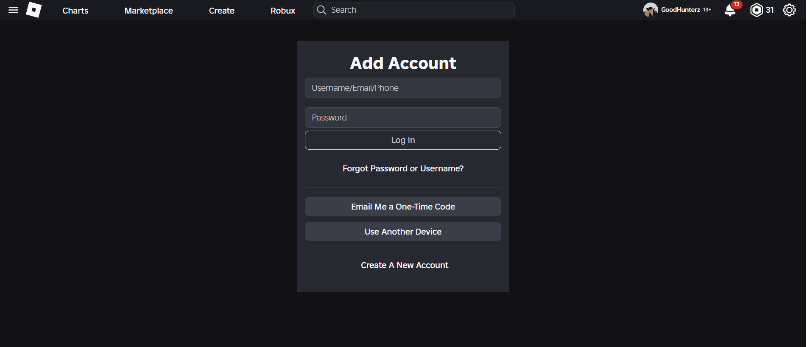
Login Roblox Page
Purpose:
Ensure that only authenticated Roblox players can access account-specific features, such as gamepass purchases or community interactions.
Maintain security by not storing any user credentials on the Terracore website — authentication is fully handled by Roblox.
How It Works:
The user clicks the "Login" link in the navigation bar.
They are redirected to Roblox’s secure login system.
Once logged in, they can return to Terracore’s site or game to enjoy member-exclusive features.
If user click again the login button, user can add roblox account
The login link in the navigation bar redirects users to the Roblox login page, allowing them to sign in with their Roblox account.

Slide 29

ADDITIONAL
SECTION

Slide 30
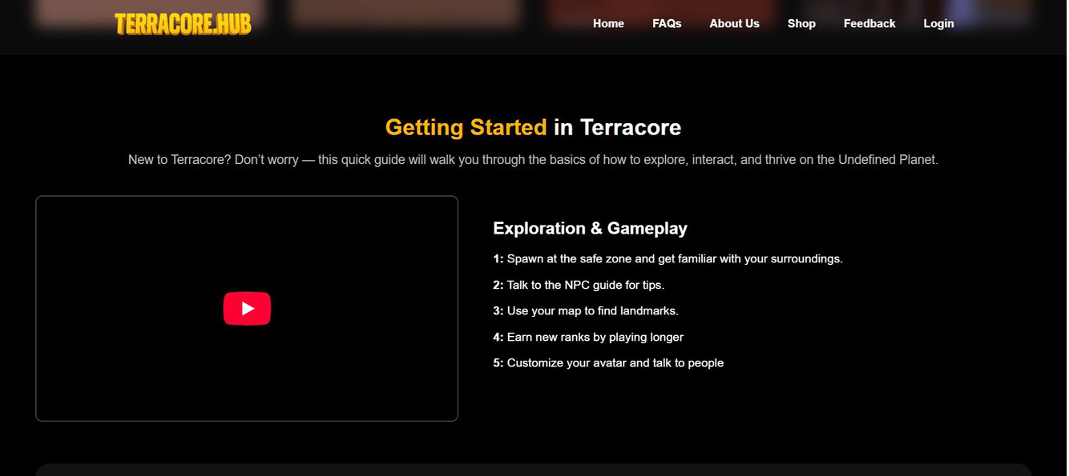
Home Page - Tutorial
Section
The Tutorial Section serves as a complete beginner’s guide for new players entering the world of Terracore. It explains the essential steps to start playing, from setting up the game to exploring its core features. The tutorial walks players through the controls, navigation, and interaction system, ensuring they feel comfortable in the environment.
It also introduces key gameplay mechanics such as completing quests, using tools, and participating in events. By following the tutorial, players not only learn how to survive in Terracore’s vast and dynamic world but also discover how to connect with the community, take part in adventures, and progress in their journey.

Slide 31
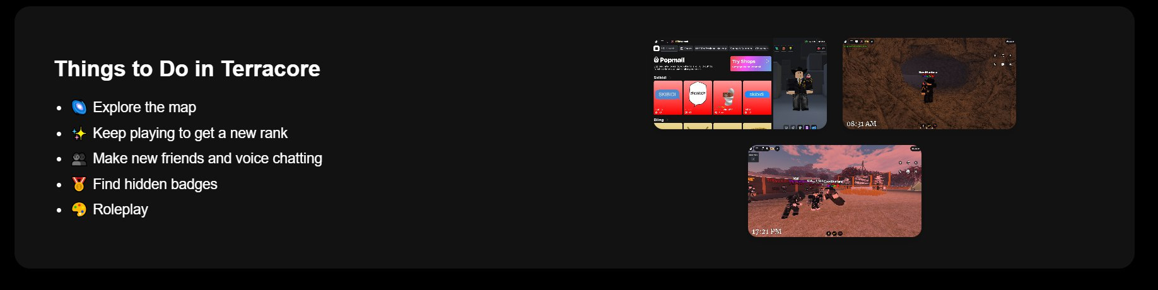
Home Page - Tutorial Section
(Items and Gallery)

Slide 32
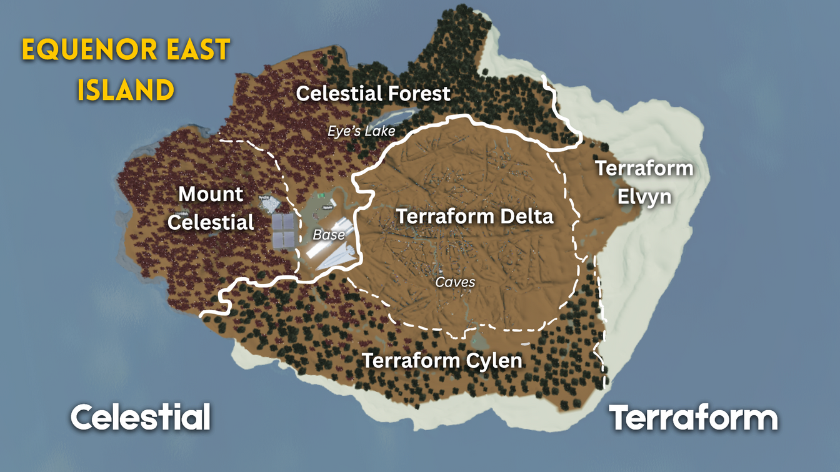
Home Page - Terracore Map Section
The Map Section showcases the world of Terracore, giving players a visual overview of the different regions and locations they can explore in-game.

Slide 33
Main Features
Purpose
Main Map Display: Shows the full view of Equenor East Island, the primary world map.
Thumbnails of Key Locations: Each thumbnail represents a unique area in the game, such as:
Base – The main spawn and gathering point for players.
Mount Celestial – A towering mountain with breathtaking views and hidden paths.
Celestial Forest – A lush, green forest teeming with life and secrets.
Terraform Delta – A river delta region with diverse terrain.
Terraform Cylen – A mysterious area with experimental terrain formations.
Terraform Elvyn – A magical landscape with vibrant, otherworldly features.
Provide players with a preview of the game’s world.
Allow newcomers to familiarize themselves with important locations before exploring.
Visually highlight the diversity of Terracore’s environments.

Slide 34
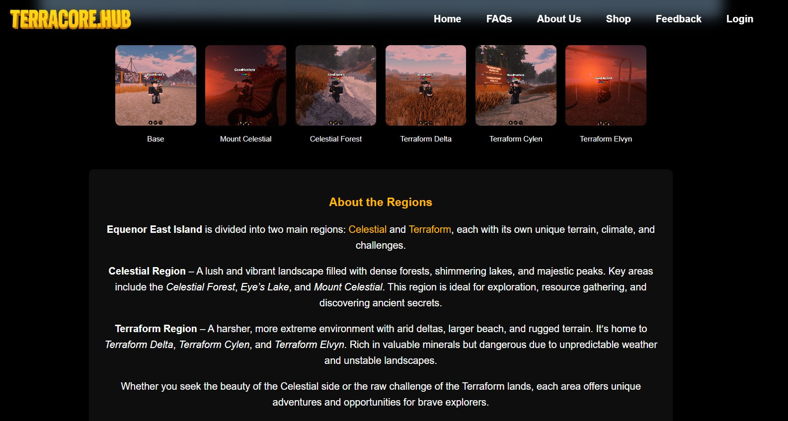
Home Page - Terracore Map Section (Gallery and Description)

Slide 35
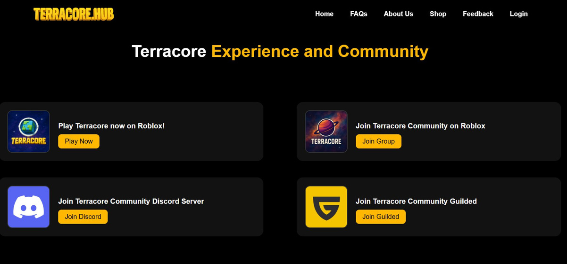
Home Page - Community
Page
Central hub for players to connect, collaborate, and stay informed about everything happening in Terracore. It highlights official social media platforms, discussion groups, and in-game community spaces where members can share ideas, give feedback, and participate in events

Slide 36
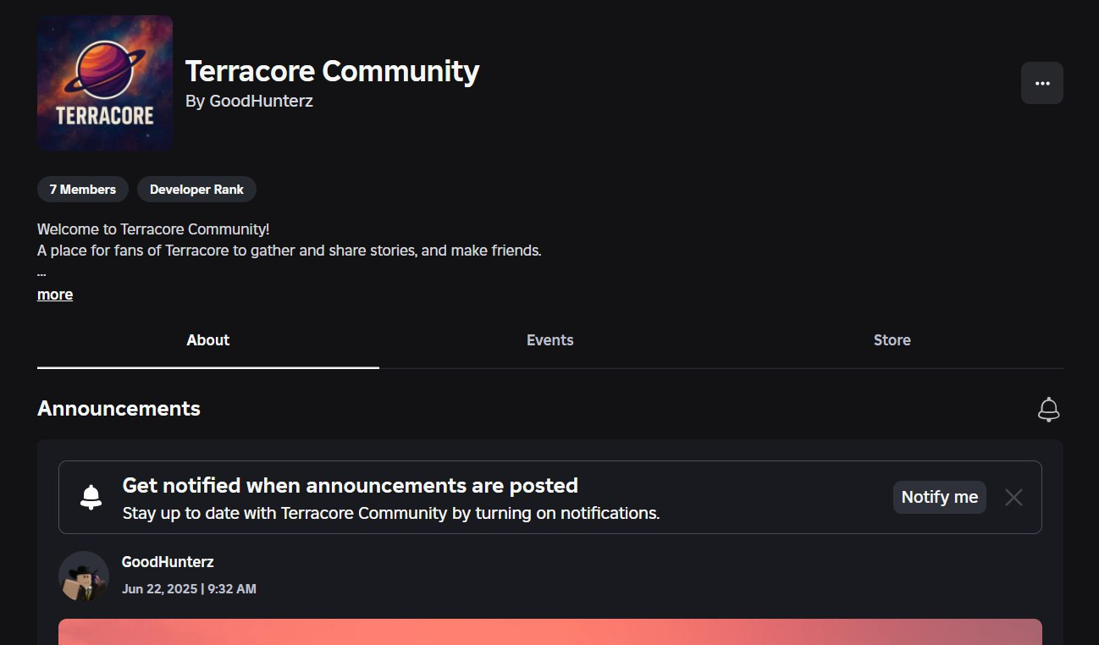
Roblox Community Page

Slide 37
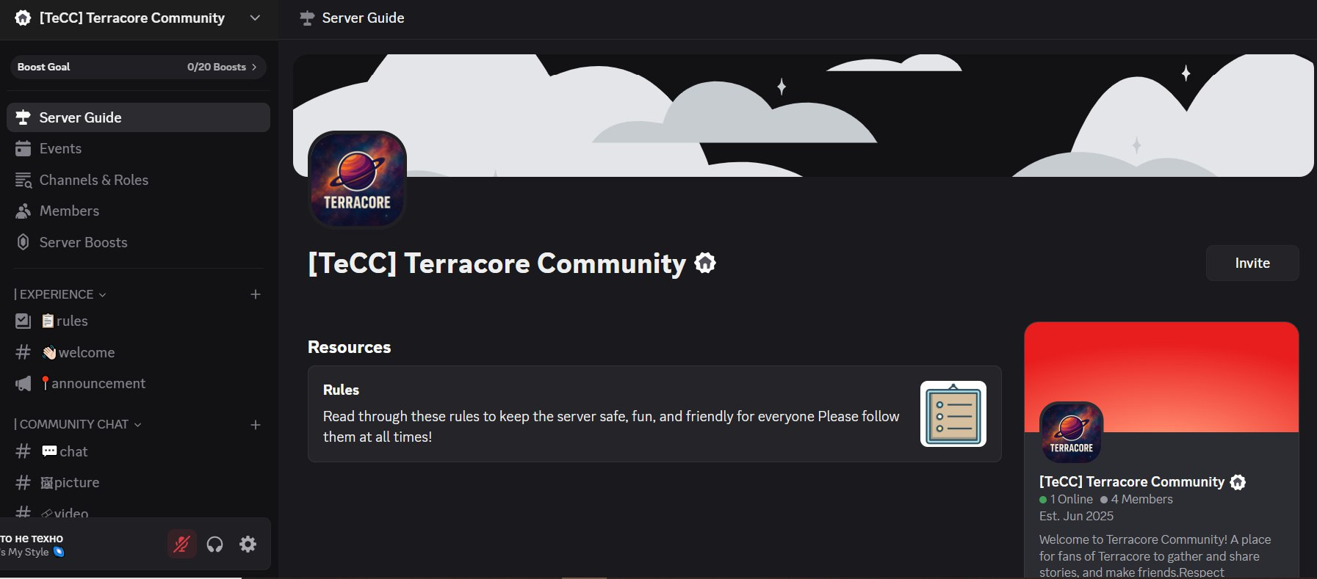
Discord Server Page

Slide 38
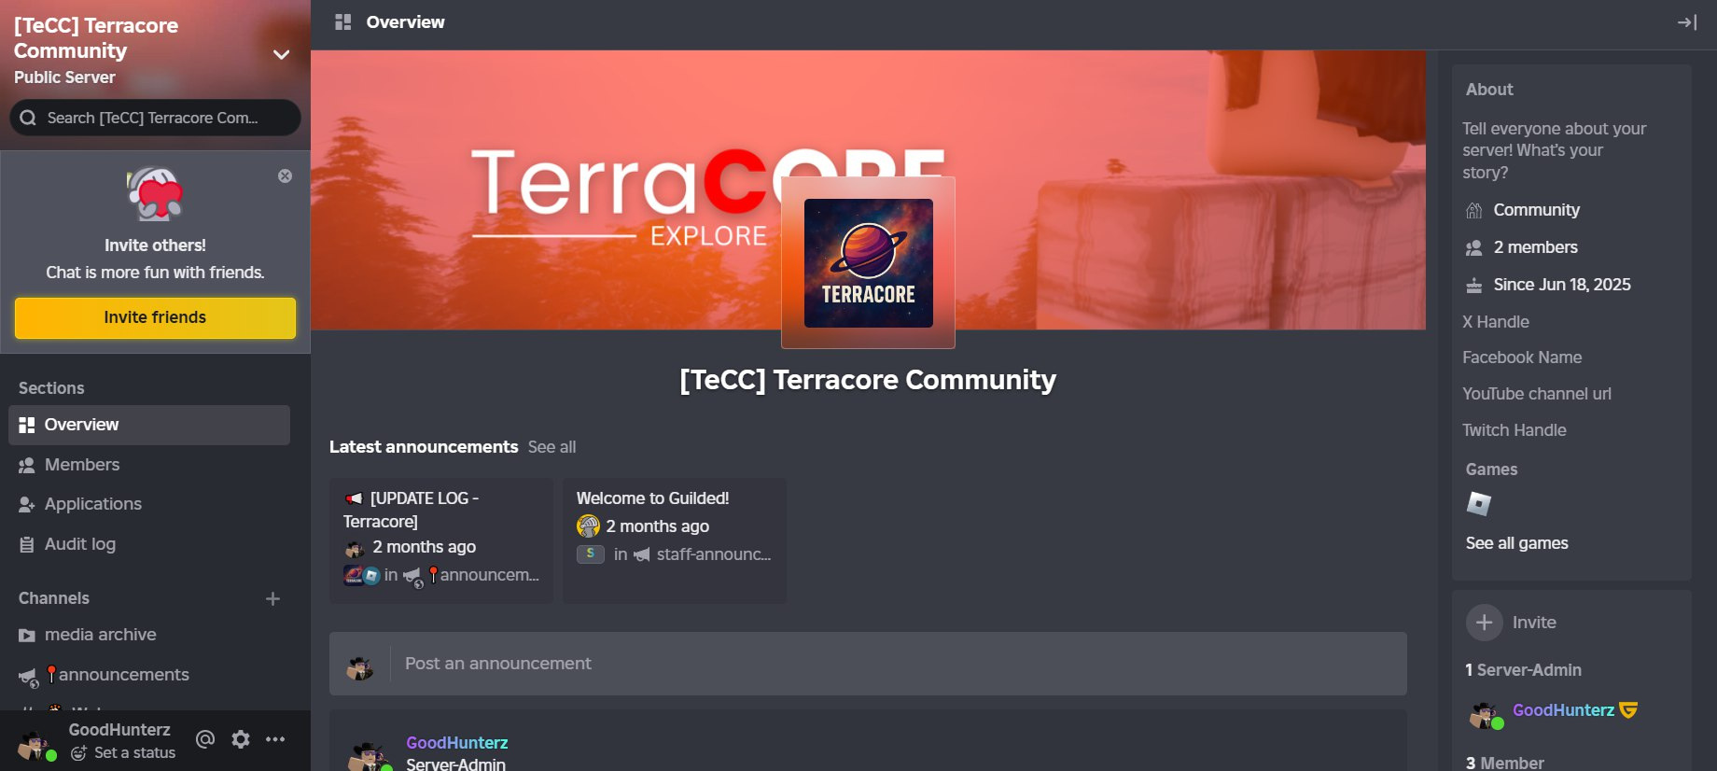
Guilded Server Page

Slide 39
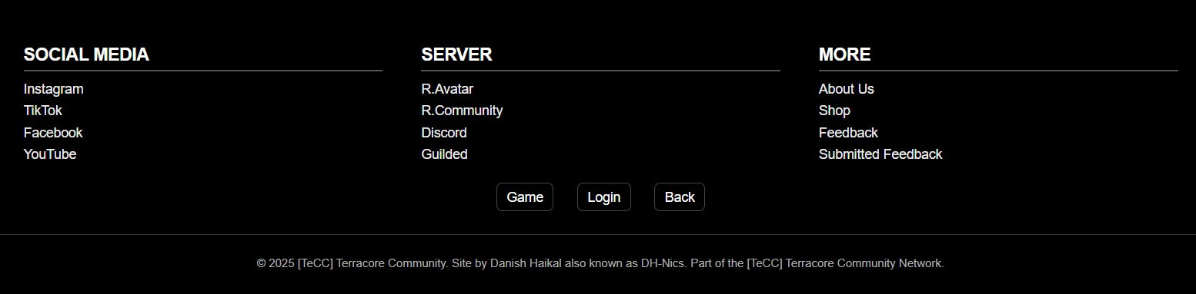
Footer Section
The footer provides quick navigation to key areas, including social media, server links, and important site pages. It connects players to platforms like Discord, Roblox, and YouTube while maintaining brand identity with a copyright credit to the founder and the [TeCC] Terracore Community Network.

Slide 40
Included:
Social Media
Part
Instagram: Developer’s Instagram account
Tiktok: Developer’s Tiktok account
Facebook: Developer’s Facebook account
Youtube: Developer’s Youtube account

Slide 41
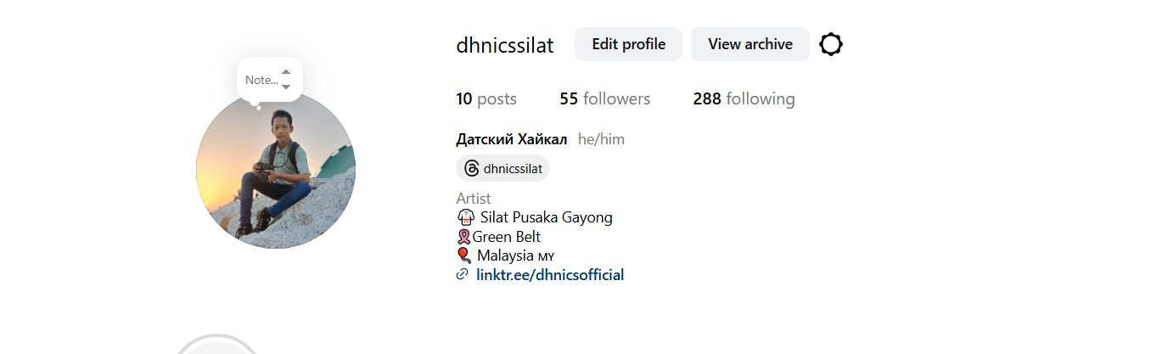

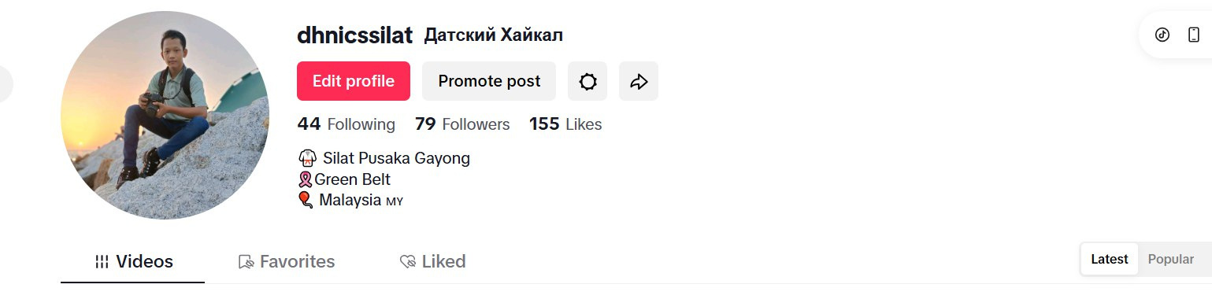

Instagram:
Facebook:
Tiktok:
Youtube:

Slide 42
Included:
Server
Part
Roblox Avatar: Developer Roblox Avatar
Roblox Community: Page 34
Discord: Page 35
Guilded: Page 36
Game Button: Page 8
Login Button: Page 24
Back Button: Return to home button

Slide 43
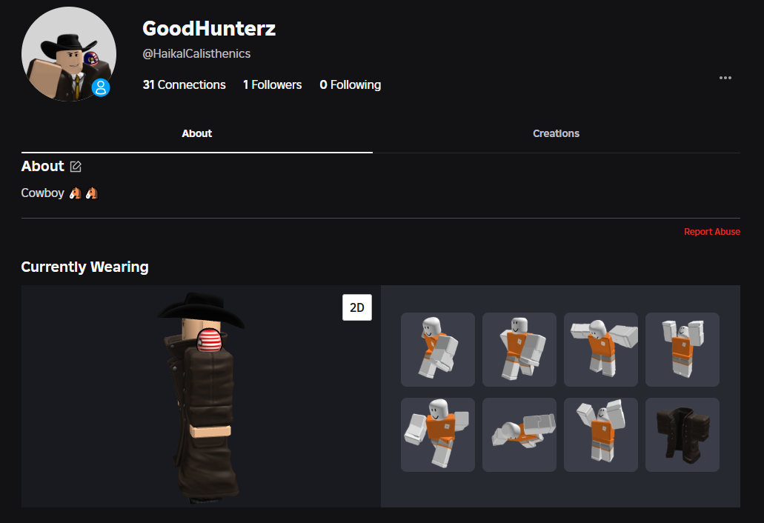
Roblox Avatar

Slide 44
Included:
More
Part
About Us: Page 16
Shop: Page 19
Feedback: Page 23
Submitted Feedback: Page 24

Slide 45
Q&A
Ask any question (in Malay)

Slide 46
TERRACORE
COMMUNITY
THANK YOU
TO Y’ALL
Thank You For Y’all For Focusing On Our Slide
<<< Made by >>>
Danish & farriz

